Slide 1
Boolean Algebra

Slide 2
INTRODUCTION
Because binary logic is used in all of today’s digital computers and devices, the cost of the circuits that implement it is an important factor addressed by designers—be they computer engineers, electrical engineers, or computer scientists.
Finding simpler and cheaper, but equivalent, realizations of a circuit can reap huge payoffs in reducing the overall cost of the design.
Mathematical methods that simplify circuits rely primarily on Boolean algebra.
Therefore, this topic provides a basic vocabulary and a brief foundation in Boolean algebra that will enable you to optimize simple circuits and to understand the purpose of algorithms used by software tools to optimize complex circuits involving millions of logic gates.

Slide 3
Boolean Algebra
Boolean algebra, like any other deductive mathematical system, may be defined
with
a set of elements, a set of operators, and
a number of unproved axioms or postulates.

Slide 4
BASIC DEFINITIONS
The most common postulates used to formulate various algebraic structures are:
1. Closure. A set S is closed with respect to a binary operator if, for every pair of elements of S, the binary operator specifies a rule for obtaining a unique element of S.
For Example: N={1,2,3,4…}, is closed with respect to the binary operator + by the rules of arithmetic addition, since for any a,b ∈N we obtain a unique c ∈N by the operation a+b=c.
The set of natural numbers is not closed with respect to the binary operator - by the rules of arithmetic subtraction, because 2−3= −1 and 2,3 ∈N, while (−1) ∉N.
2. Associative law. A binary operator * on a set S is said to be associative whenever
(x * y) * z = x * (y * z) for all x, y, z, ∈ S
3.Commutative law. A binary operator * on a set S is said to be commutative whenever
x * y = y * x for all x, y∈ S

Slide 5
Identity element
4. Identity element. A set S is said to have an identity element with respect to a binary operation * on S if there exists an element e ∈ S with the property that
e * x = x * e = x for every x ∈ S
Example: The element 0 is an identity element with respect to the binary operator + on the set of integers
I = {. . ., -3, -2, -1, 0, 1, 2, 3,. . .},
since x + 0 = 0 + x = x for any x ∈ I
The set of natural numbers, N, has no identity element, since 0 is excluded from the set.

Slide 6
Inverse
5. Inverse. A set S having the identity element e with respect to a binary operator * is said to have an inverse whenever, for every x ∈ S, there exists an element y ∈ S such that
x * y = e
Example: In the set of integers, I, and the operator +, with e = 0, the inverse of an element a is (-a), since a + (-a) = 0.

Slide 7
Distributive law
6. Distributive law. If * and . are two binary operators on a set S, * is said to be distributive over .
x * (y . z) =(x * y) . (x * z)

Slide 8
Basic Definitions
The operators and postulates have the following meanings:
The binary operator + defines addition. The additive identity is 0. Ex. a + 0 =0 + a
The additive inverse defines subtraction.
The binary operator . defines multiplication.
The multiplicative identity is 1. The multiplicative inverse of a = 1/a defines division, i.e., a . 1/a = 1
The only distributive law applicable is that of . over +:
a . (b + c) = (a . b) + (a . c)
8

Slide 9
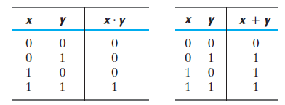
Axiomatic Definition of Boolean Algebra
Boolean algebra is defined by a set of elements, B, provided following postulates with two binary operators, + and ., are satisfied:
1. (a) The structure is closed with respect to the operator +.
(b) The structure is closed with respect to the operator . .
The structure is closed with respect to the two operators is obvious from the tables, since the result of each operation is either 1 or 0 and 1, 0 ∈ B.
9

Slide 10
2. (a) The element 0 is an identity element with respect to +;
that is, x + 0 = 0 + x = x.
(b) The element 1 is an identity element with respect to . ;
that is, x . 1 = 1 . x = x.
3. (a) The structure is commutative with respect to +;
that is, x + y = y + x.
(b) The structure is commutative with respect to . ;
that is, x . y = y . x.
4. (a) The operator . is distributive over +;
that is, x . (y + z) = (x . y) + (x . z).
(b) The operator + is distributive over . ;
that is, x + (y . z) = (x + y). (x + z).

Slide 11
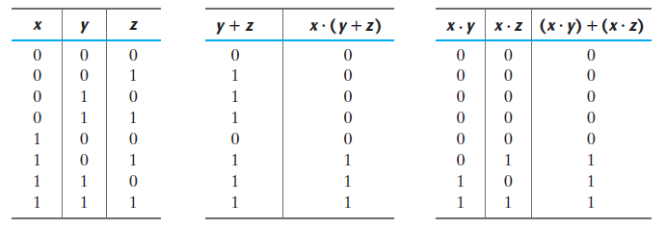

Slide 12
5. For every element x ∈ B, there exists an element x ∈ B (called the complement of x) such that
(a) x + x’ = 1
since 0 + 0’ = 0 + 1 = 1 and 1 + 1’ = 1 + 0 = 1.
(b) x . x’ = 0.
since 0 . 0’ = 0 . 1 = 0 and 1 . 1’ = 1 . 0 = 0.
6. There exist at least two elements x, y ∈ B such that x ≠ y.

Slide 13
Duality principle
Duality principle states that every algebraic expression deducible from the postulates of Boolean algebra remains valid if the operators and identity elements are interchanged.
In a two‐valued Boolean algebra, the identity elements and the elements of the set B are the same: 1 and 0.
The duality principle has many applications. If the dual of an algebraic expression is desired, we simply interchange OR and AND operators and replace 1’s by 0’s and 0’s by 1’s.

Slide 14
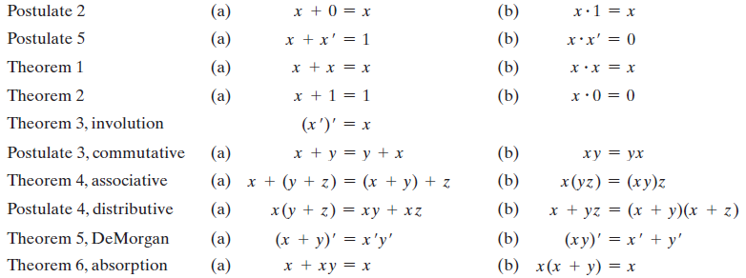
Postulates and Theorems
14

Slide 15
Basic Theorems
Theorem 1(a): x + x = x
= (x + x) . 1
by postulate 2(b)
5(a)
4(b)
5(b)
2(a)
= (x + x) . (x + x’)
= x + xx’
= x + 0
= x
Dual
Dual
back
Theorem 1(b): x . x = x
= x . x + 0
by postulate 2(a)
5(b)
4(a)
5(a)
2(b)
= xx + xx’
= x (x + x’)
= x . 1
= x

Slide 16
THEOREM 2(a): x + 1 = 1.
Statement Justification
x + 1 = 1 . (x + 1) postulate 2(b)
= (x + x’)(x + 1) 5(a)
= x + x’ . 1 4(b)
= x + x’ 2(b)
= 1 5(a)
THEOREM 2(b): x . 0 = 0
by applying duality property.

Slide 17
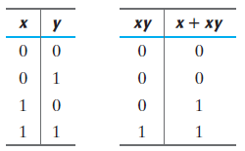
THEOREM 6(a): x + x y = x.
(Method-1)
Statement Justification
x + x y = x . 1 + x y postulate 2(b)
= x(1 + y) 4(a)
= x(y + 1) 3(a)
= x . 1 2(a)
= x 2(b)
(Method-2)
THEOREM 6(b): x (x + y) = x
by applying duality property.

Slide 18
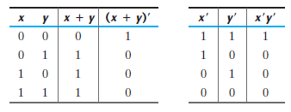
DeMorgan’s theorem

Slide 19
Operator Precedence
The operator precedence for evaluating Boolean expressions is
(1) parentheses
(2) NOT
(3) AND
(4) OR
In other words, expressions inside parentheses must be evaluated before all other operations. The next operation that holds precedence is the complement, and then follows the AND and, finally, the OR.

